Slide 1
Box Sortation Manager Office Hours

Slide 2
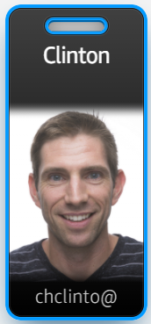
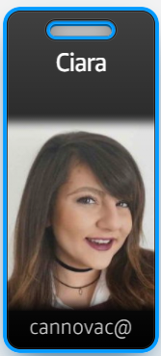
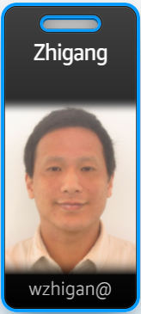

Clinton Chadwick
RME
Ciara Cannova
Process Engineering
(Operations POC)
Zhigang Wu
Systems Engineer

Slide 3
Problem Statement:
In current state, changing the routing profile of box types between the flat sorter and shipping sorter is completely manual or limited to an in house solution (aka Emerald) that will no longer be supported. The manual process involves a manager or a member of the RME team going to each SLAM station PLC and entering box barcodes and weight individually. The in house solutions are run through 3P software and updates to each individual application is not scalable.
Goal Statement:
Box Sortation Manager is an application hosted on the C4 dashboard allowing operators and RME teams to virtually connect to the SLAM HMI. Box types controlled by the application will be limited to box types approved for use on both the flat sorter and the shipping sorter to avoid misconfiguration that leads to jams. Changes in box suites and temporary box codes such as promotional boxes will be accommodated through a SIM process accessible in the application’s UI. Real time box code routing changes will take place in a dashboard controlled virtually by the Dock POC, Flow, or a member of the RME team.

Slide 4
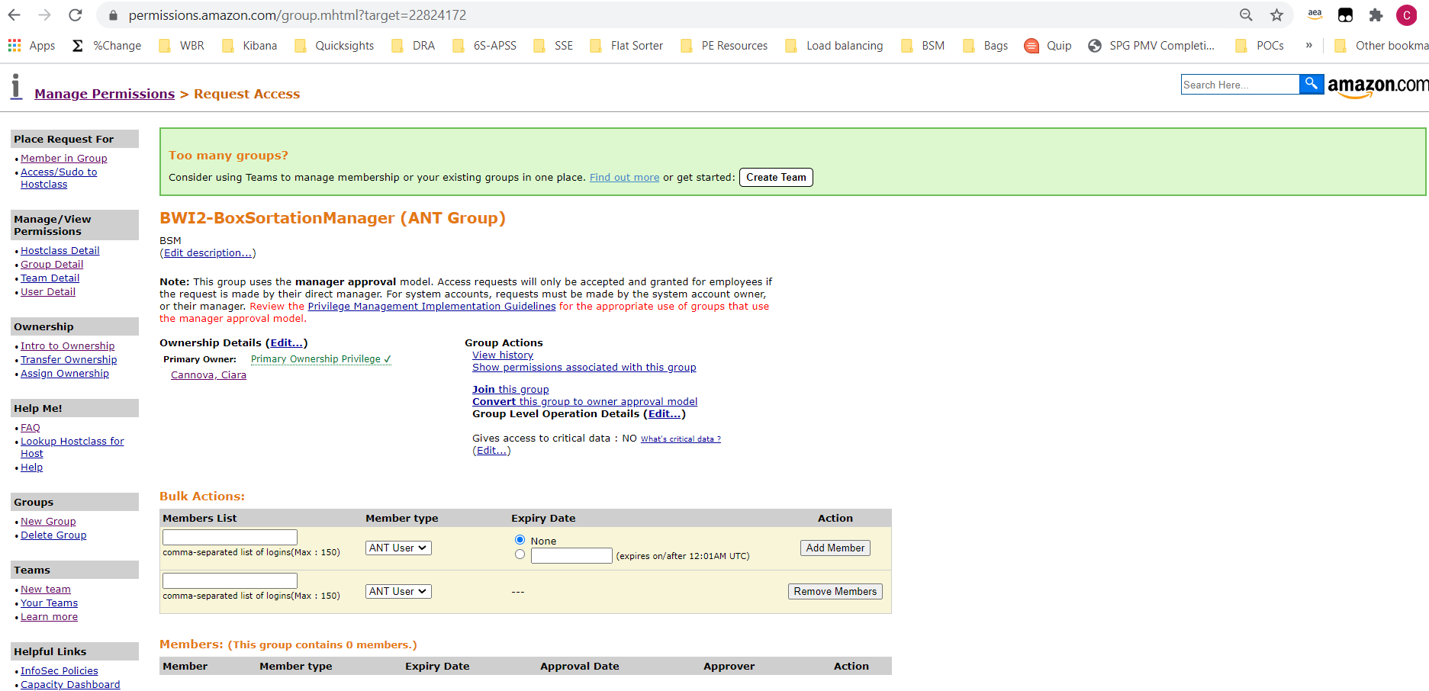
MUST be the ANT group
Search for site permissions
Initial Configuration
Permissions
Each site must have a L4+ POC from each shift attend one of the launch calls for training
Ensure all trained users are added to ANT group permissions through manager approval (ie. BDL3-BoxSortationManager (ANT Group))
https://permissions.amazon.com/

Slide 5
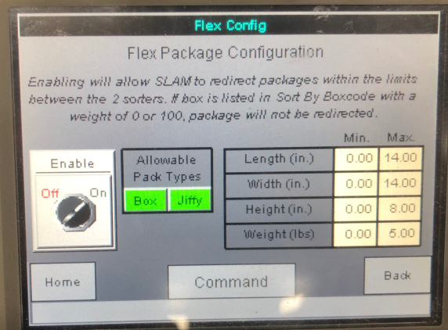
Remove dimension configuration
Initial Configuration
Flex Sort Configurations
Remove any “flex sort” dimension configurations at each slam line HMI before configuring box codes (please note weight configurations should remain)
Keep weight configuration

Slide 6
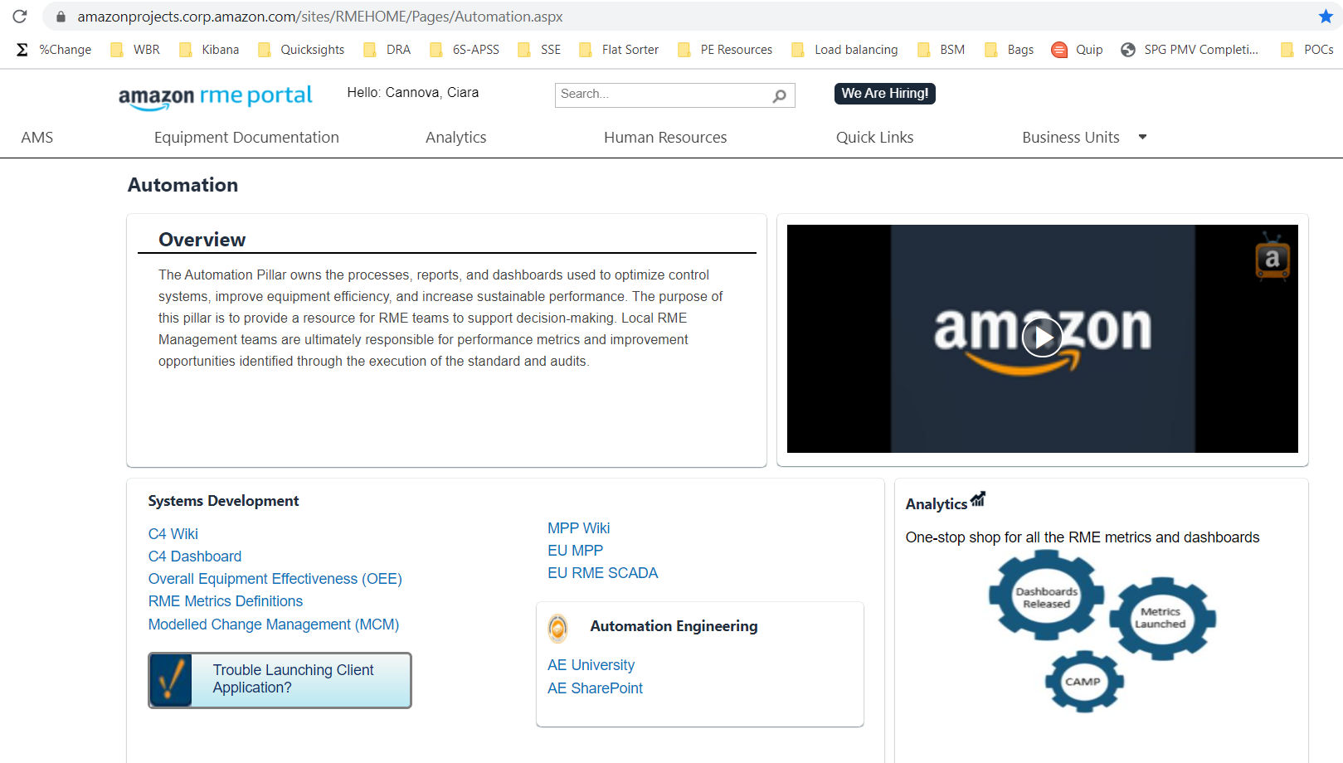
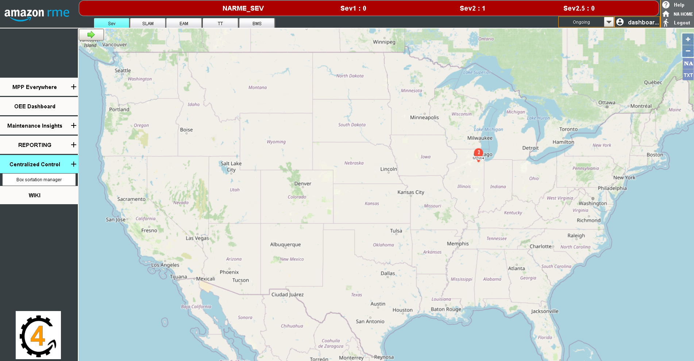
Navigating to BSM
C4 Dashboard
https://amazonprojects.corp.amazon.com/sites/RMEHOME/Pages/UpcomingPages.aspx
Centralized Control > Box Sortation Manager > Login with Amazon Credentials

Slide 7
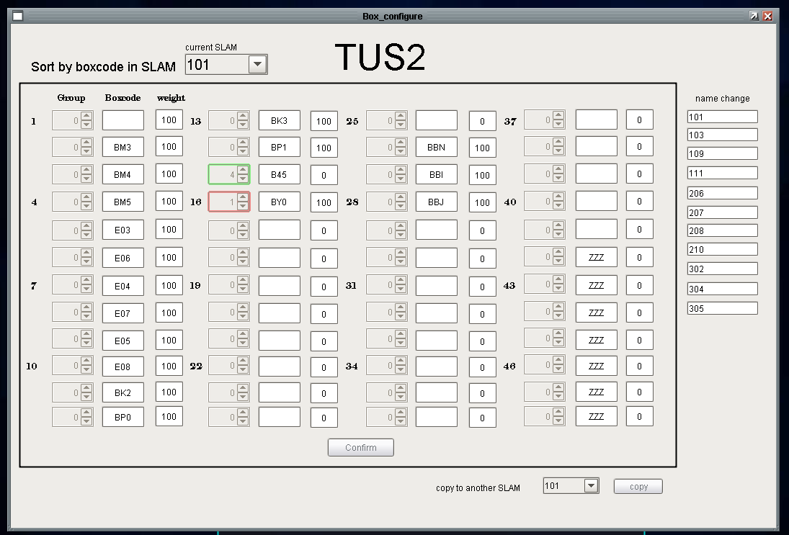
1. Enter all approved box codes in separate fields
2. Enter with a weight of 0 if no routing changes are desired at that time
Initial Configuration
Slam Line Configuration
Configure box types that are approved for dual sorter use (BY0, Z01, BY1, Z02, BNA, Z03, B45, Z05, Z06, Z04, and Z08) in each slam line through “SLAM_configure”, this will cause slam lines to update immediately so please ensure there is a OPS and RME POC on each shift with access prior to first configuration
3. Confirming will apply all changes to SLAM lines
4. Select next slam line
5. Copy to slam line

Slide 8
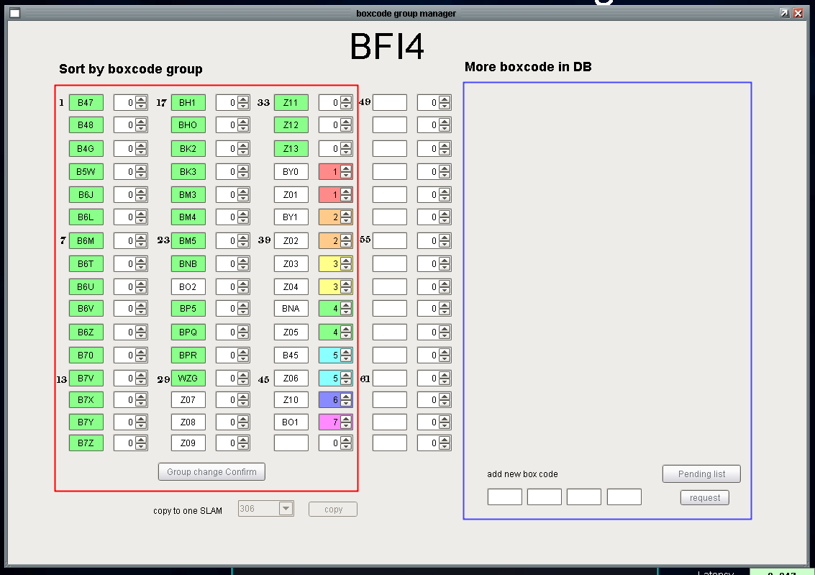
Box codes of similar sizes should be grouped together
Initial Configuration
Group Configuration
Configure groups per the outline below through “group_configure”
Group 1: BY0 and Z01
Group 2: BY1 an Z02
Group 3: BNA and Z03
Group 4: B45 and Z05
Group 5: Z06
Group 6: Z04
Group 7: Z08
There is a maximum of 7 groups
Request additional box codes if needed (promotional boxes)
Confirm group changes
Select next slam line and copy configuration

Slide 9
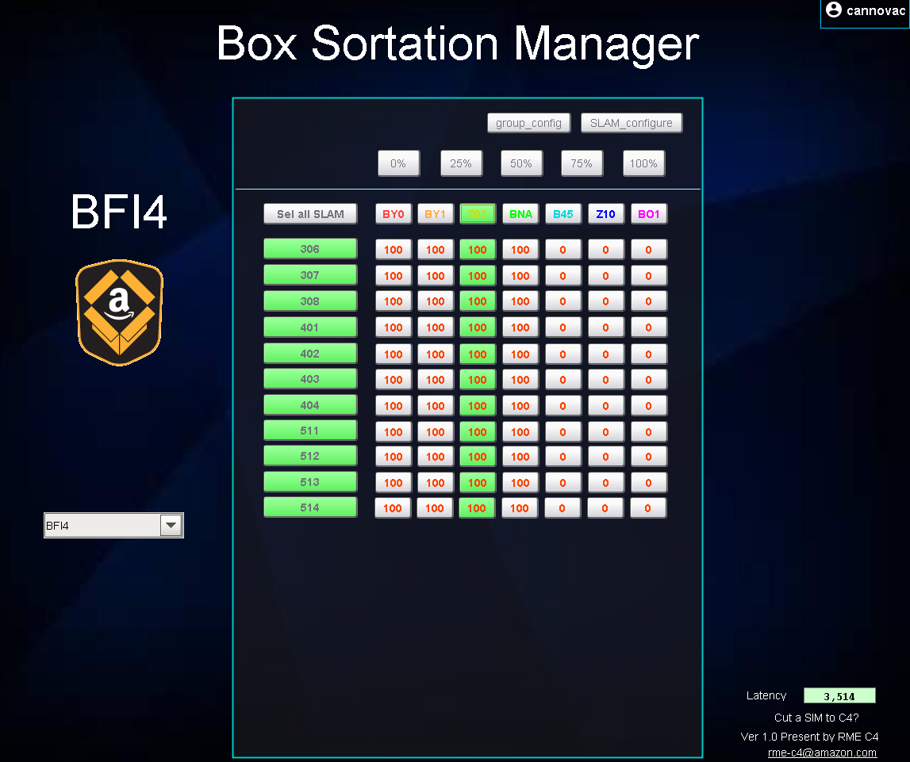
Making Changes
Slam Line Changes
Operators can make changes for multiple slam lines at the same time and set the weight (ie percent) of total boxes diverting to the flat sorter in 25% increments.
3. Select weight (ie % of total) to send to the flat sorter
Cut a ticket to C4
Latency
1. Select slam line(s) to change
2. Select group of boxes

Slide 10
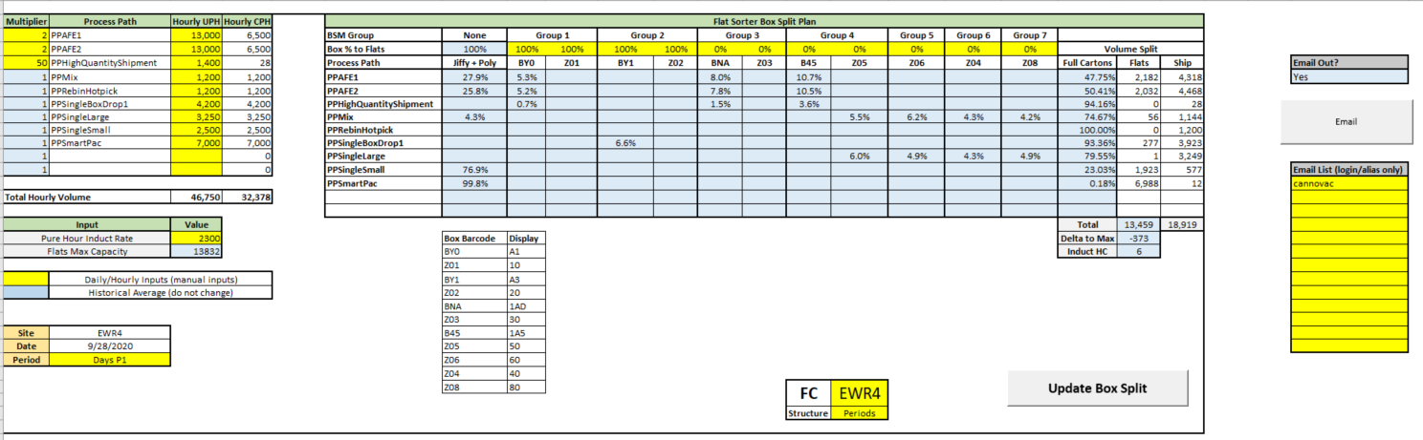
Box Split Planning
Box Planner
Box volume availability will change with the OB shift plan and should be evaluated each quarter/period of the shift. Please use Ship Dock Flat Sorter Box Planner (or current bottoms up planner) to plan box splits to the flat sorter every period/quarter.
3. Update pure hour pack throughput per OSP plan
6. Update percentage of boxes for each group until flat sorter box total is at capacity
4. Update units per shipment
7. Enter logins or aliases and send
5. Flat sorter UPH
1. Select Site and Shift Structure
2. Update Box Split

Slide 11
FAQ
How do I add new box types like promotional boxes?
Box types controlled by the application will be limited to box types approved for use on both the flat sorter and the shipping sorter, these boxes include: A1, 10, A3, 20, 1AD, 30, 1A5, 50, 60, 40, and 80. If additional box types that align with the dimensions of any of the aforementioned approved boxes please use the “add new box code” feature in “group_config” to request the addition.
Why are there delays in the changes I’m making?
The speed of the changes is dependent on the site latency (displayed in the bottom right corner of Box Sortation Manager). The client will read the updates from SLAMs in a 6 second intervals. If the new weight doesn't transmit to the SLAMs within 12 seconds, the old weight is read by client and is showing on the dashboard.
What happens if I have an issue with Box Sortation Manager?
Should you have an issue with box sortation manager changes through the HMI will still be supported, please utilize SLAM station PLC and cut a ticket (non Sev2) through the Box Sortation Manager main interface “cut a ticket to C4?”
When to contact C4 team:
Message says <no SLAM folder available in MQTT under [SITE], please wait and try later OR contact us.>
Latency is showing <offline> or a messages says <gateway offline> for more than 5 minutes.
Cannot change the value when the latency is good and a message says <access denied>
Cannot change the value on ALL slams or some SLAMs when the latency is good and with no error message
The SLAMs in the BSM is not same as site layout
How do I know which boxes I should send to the flat sorter?
Box volume availability will change with the OB shift plan and should be evaluated each quarter/period of the shift. Please use Ship Dock Flat Sorter Box Planner (or current bottoms up planner) to plan box splits to the flat sorter every period/quarter.

